Slide 1
Clustering

Slide 2
Paradigms in ML
•Supervised Learning: classification, regression, etc.
•Unsupervised Learning: clustering, dimensionality
reduction, etc.
• Reinforcement Learning

Slide 3
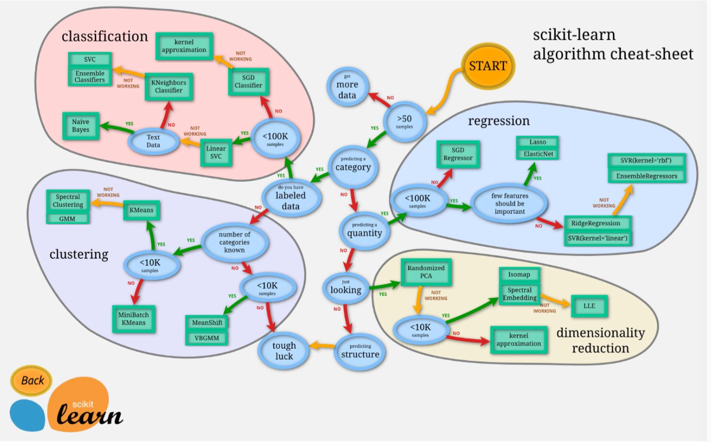
Paradigms in ML

Slide 4
Clustering, Informal Goals
Goal: Automatically partition unlabeled data into groups of similar datapoints.
Question: When and why would we want to do this? Useful for:
• Automatically organizing data. • Understanding hidden structure in data.
• Preprocessing for further analysis.
Representing high-dimensional data in a low-dimensional space

Slide 5
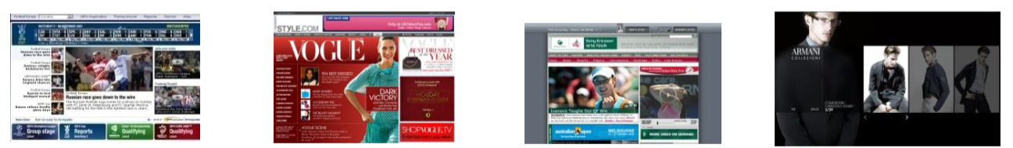
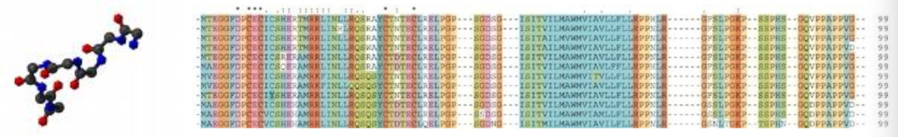
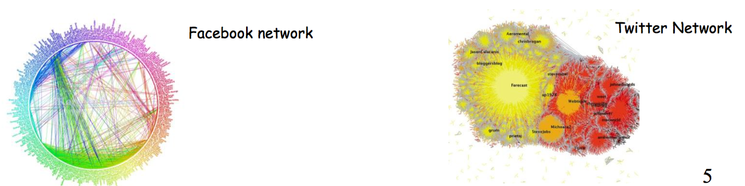
Applications
(Clustering comes up everywhere...)
Cluster news articles or web pages or search results by topic (topic modeling).
Cluster protein sequences by function or genes according to expression profile.
Cluster users of social networks by interest (community detection).

Slide 6
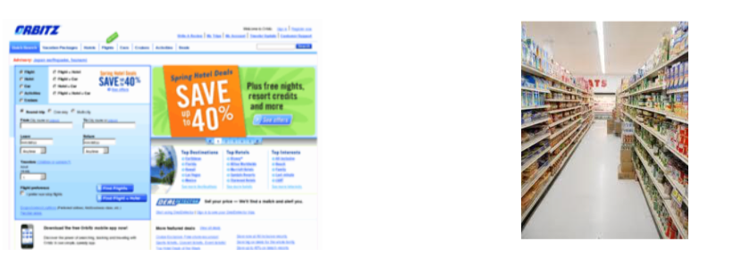
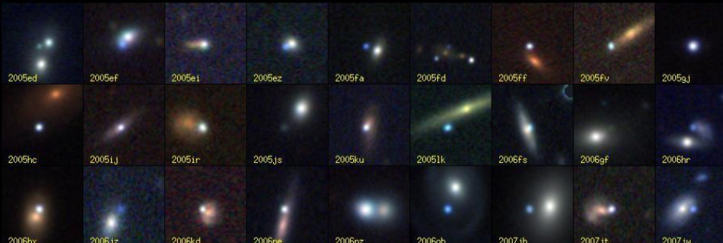
Applications
(Clustering comes up everywhere...)
Cluster customers according to purchase history(recommendation system).
Cluster galaxies or nearby stars (e.g. Sloan Digital Sky Survey)
•And many many more applications....

Slide 7
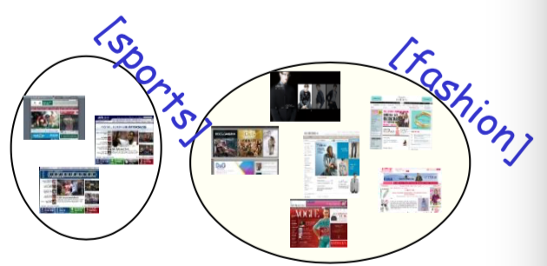
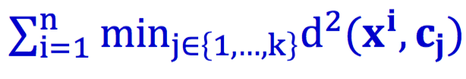
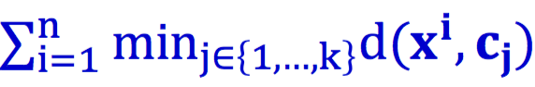
Ob
Objective Based Clustering
Input: A set S of n points, also a distance/dissimilarity
measure specifying the distance d(x,y) between pairs (x,y).
E.g., # keywords in common, edit distance, wavelets coef., etc.
Goal: output a partition of the data.
k-means: find center pts 𝒄_{𝟏}, 𝒄_{𝟐}, ... , 𝒄_{𝒌} to minimize
k-median: find center pts 𝒄_{𝟏}, 𝒄_{𝟐}, ... , 𝒄_{𝒌} to minimize
K-center: find partition to minimize the maximum radius

Slide 8
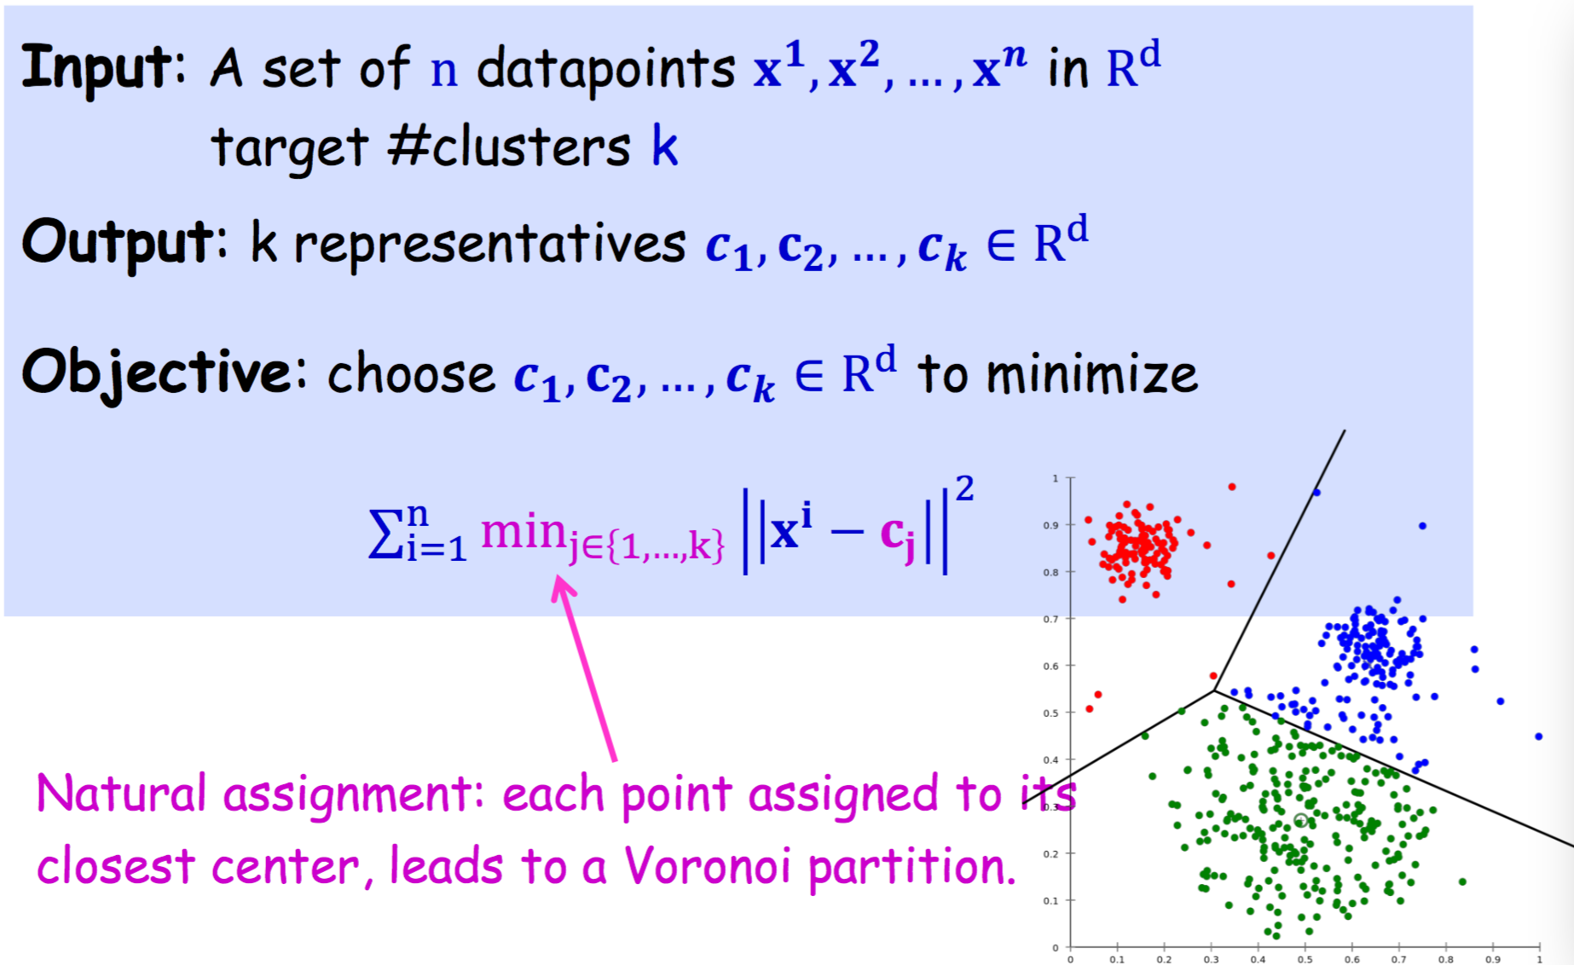
Ob
Euclidean k-means Clustering

Slide 9
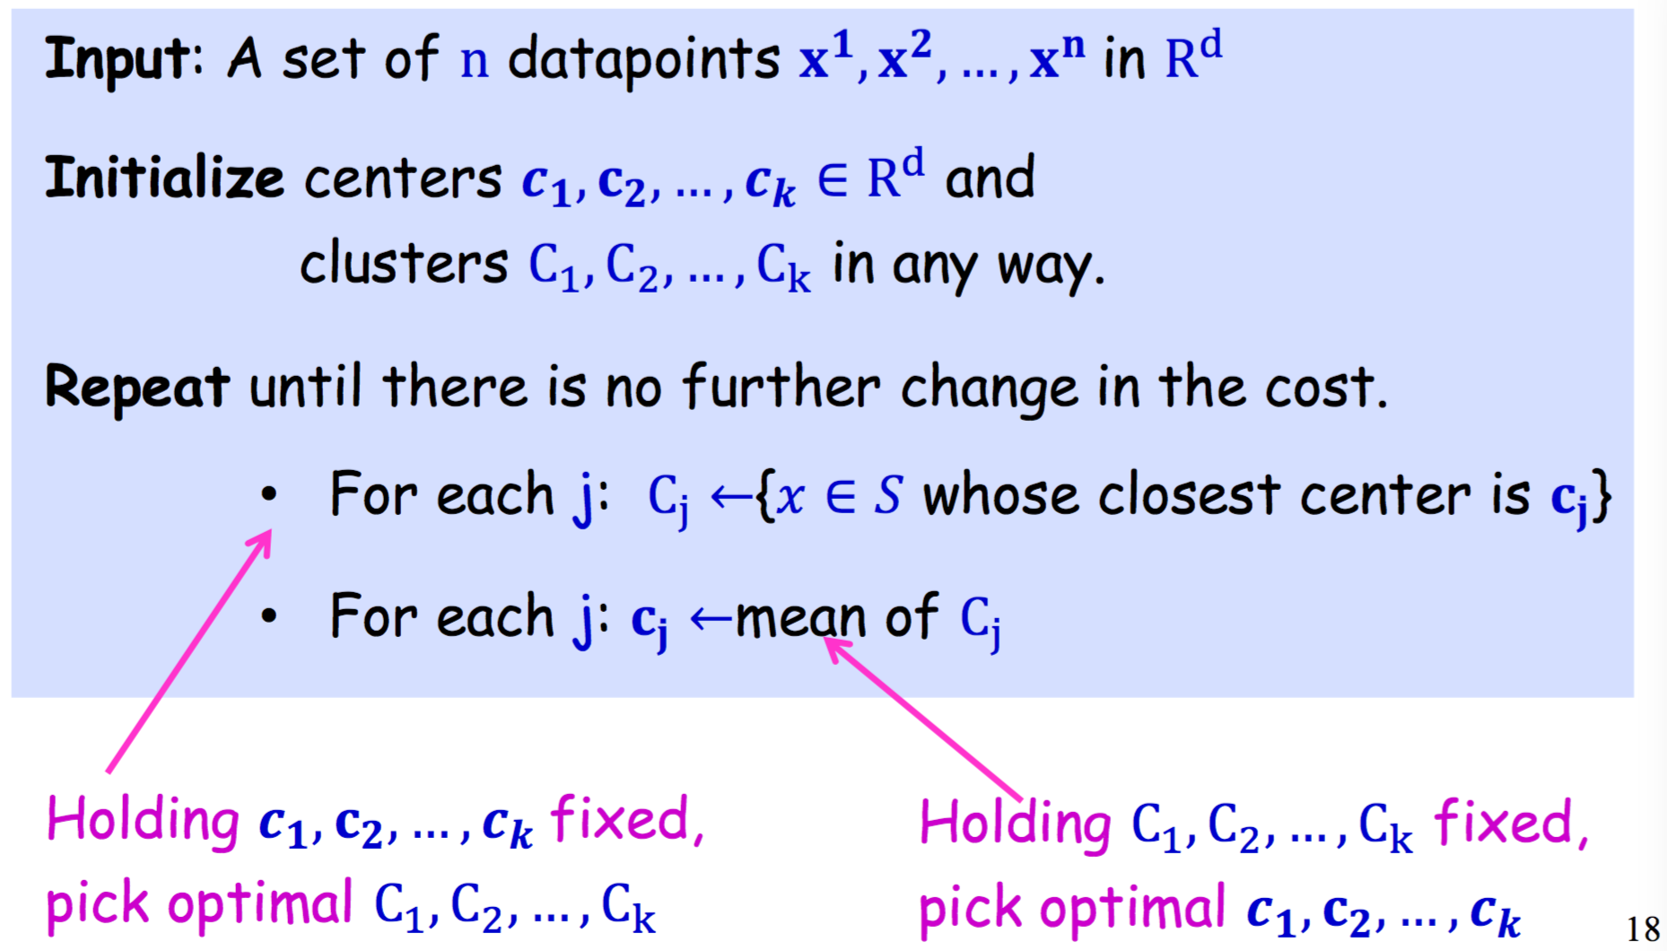
Ob
The Lloyd’s method

Slide 10
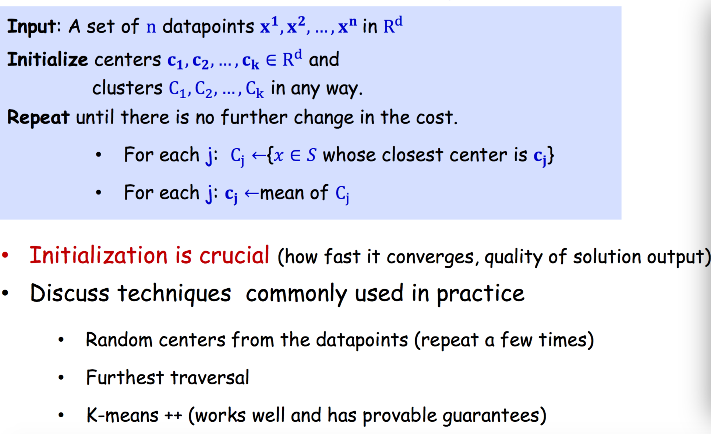
Ob
Initialization for the Lloyd’s method

Slide 11
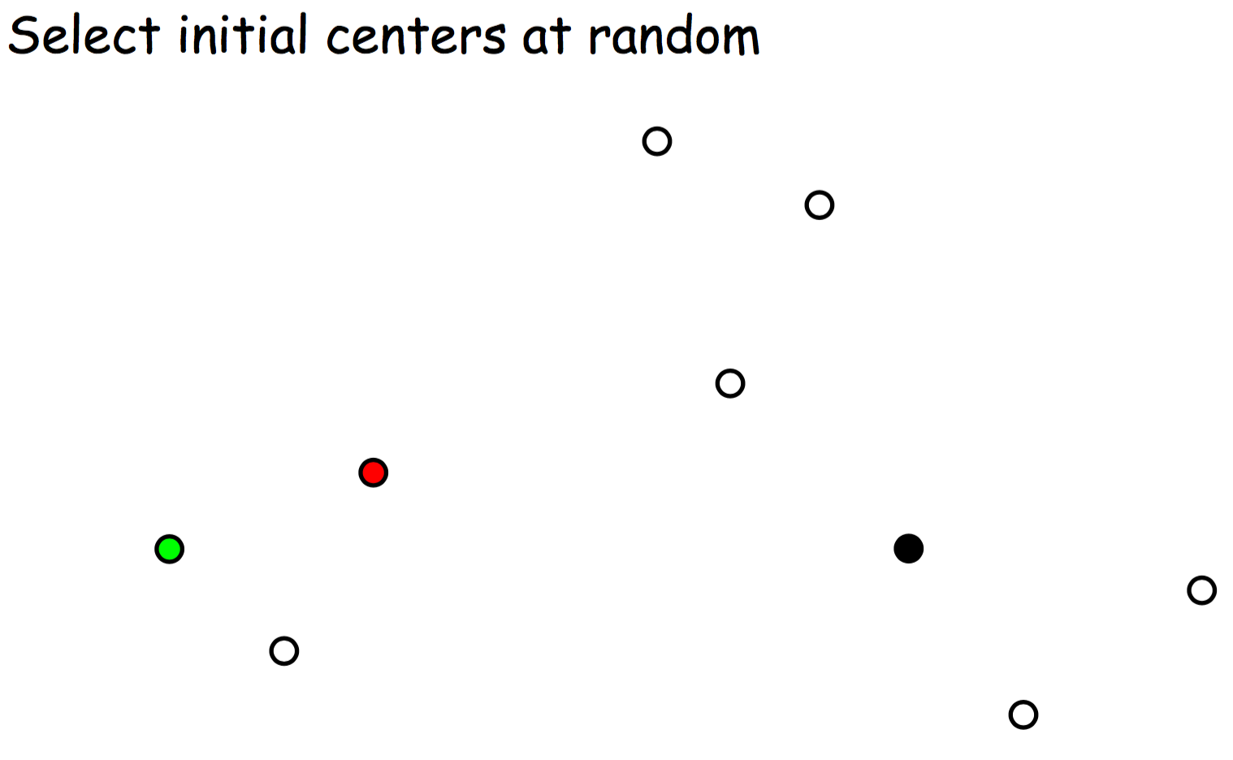
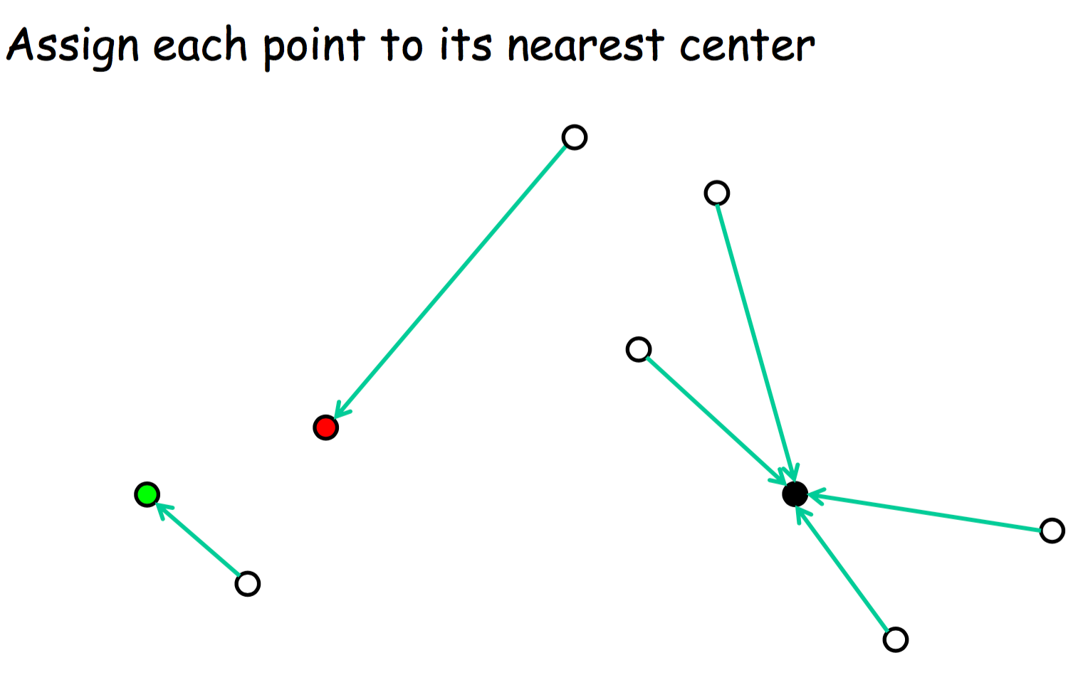
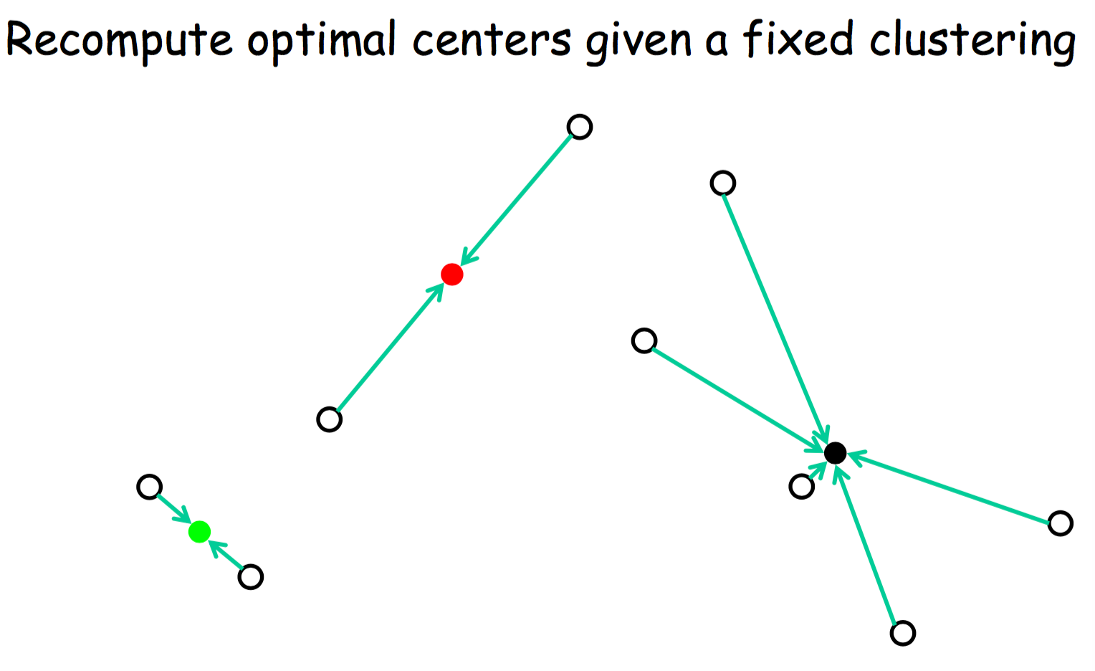
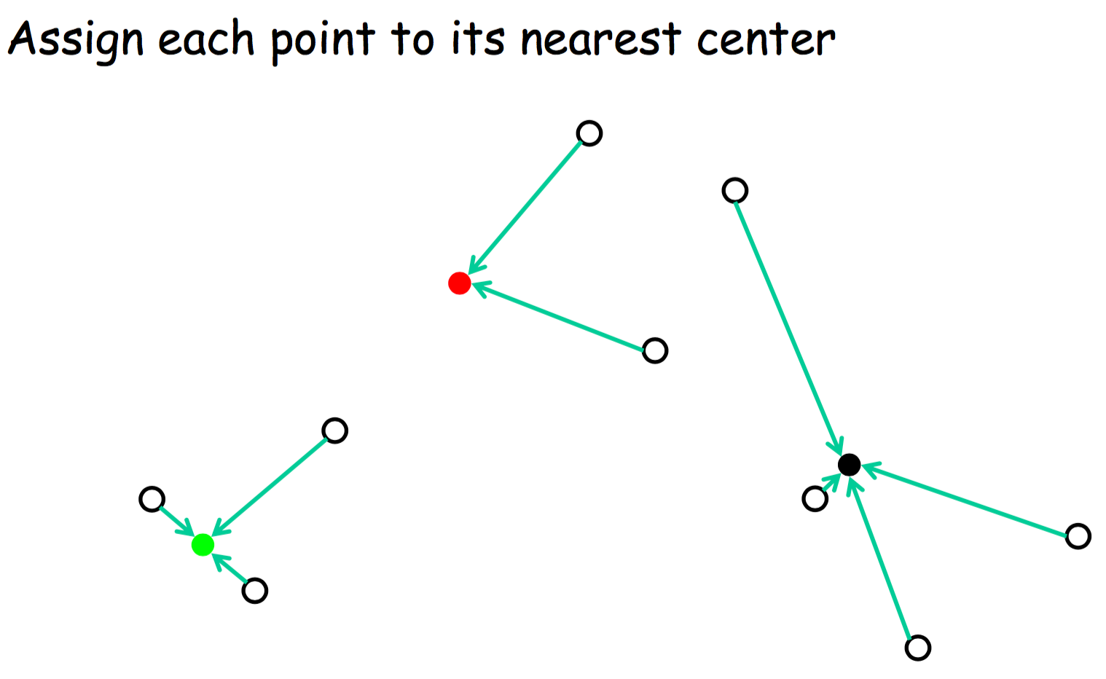
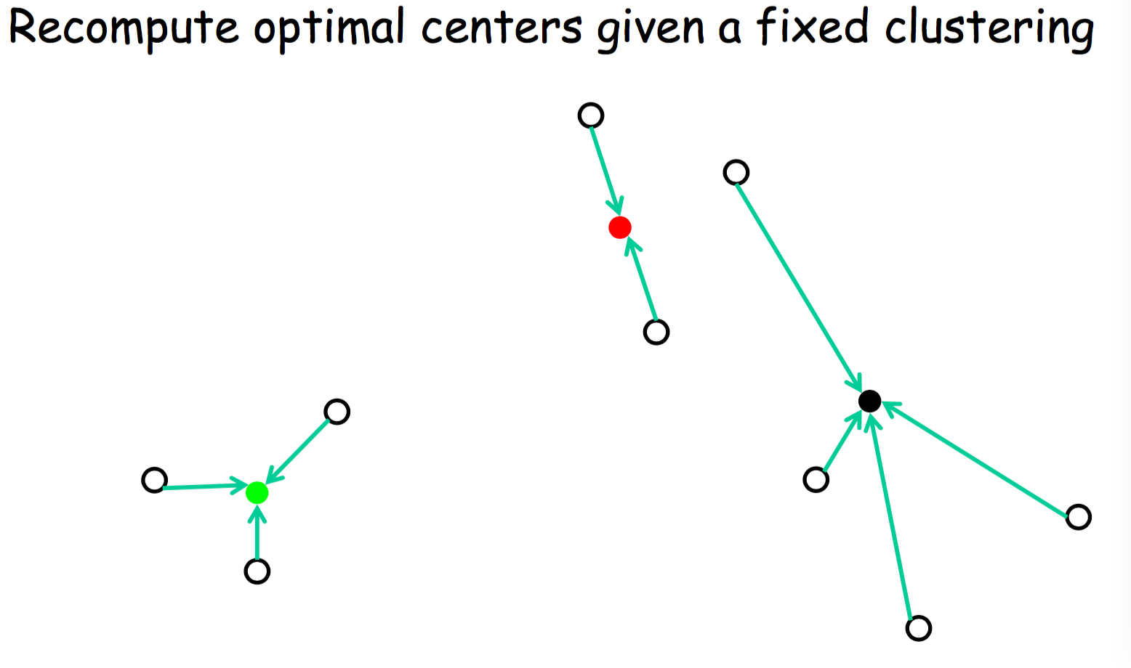
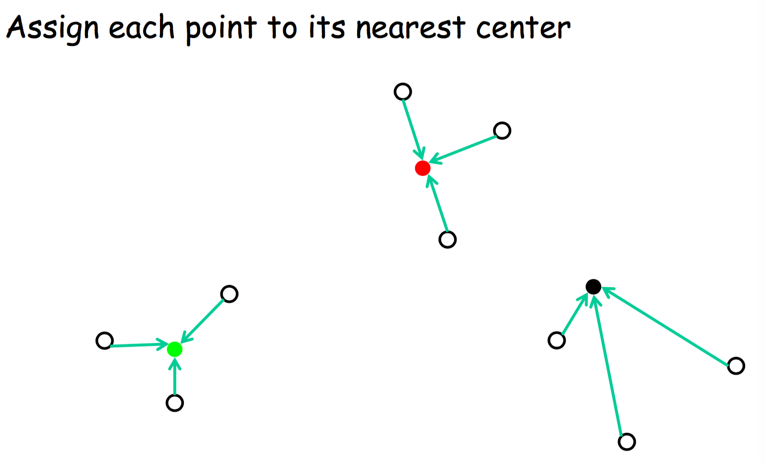
Ob
Lloyd’s method: Random Initialization

Slide 12
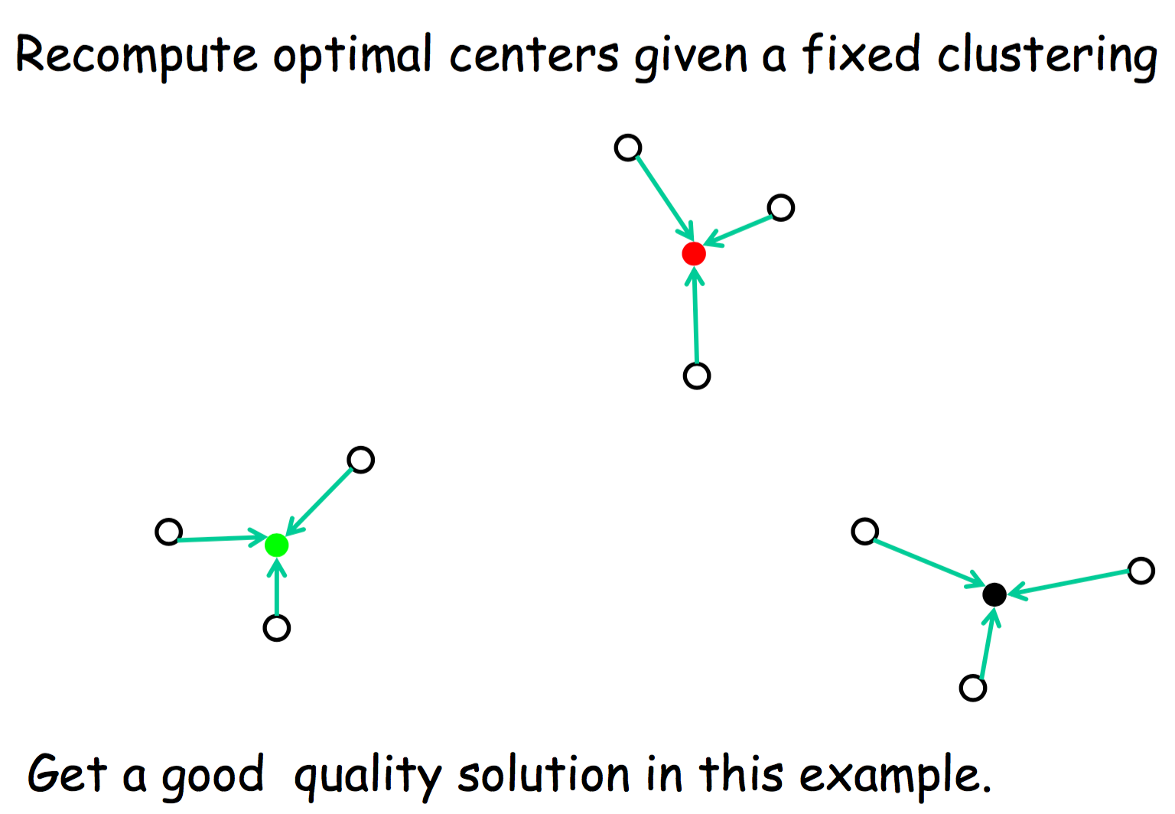
Ob
Lloyd’s method: Random Initialization

Slide 13
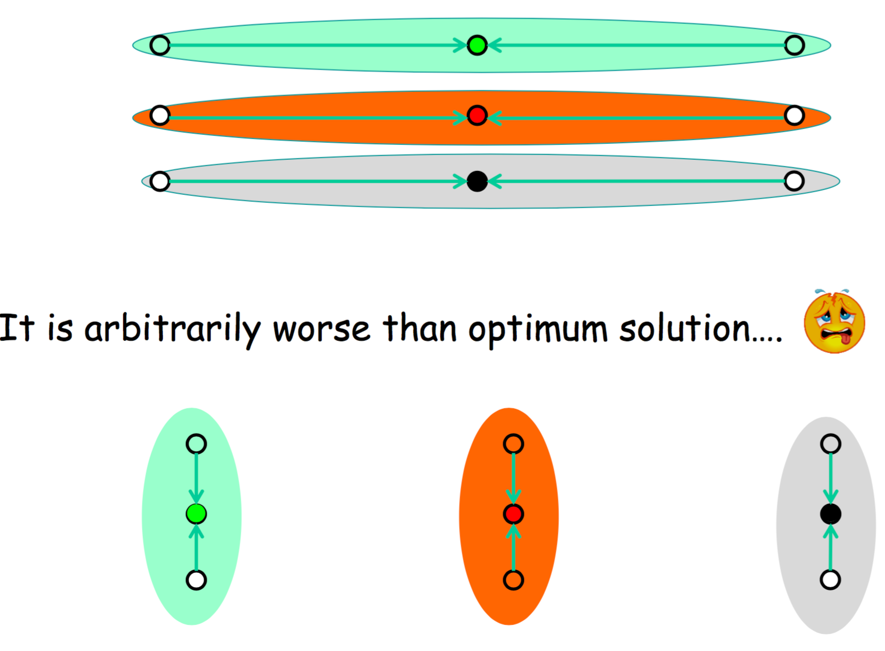
Ob
Lloyd’s method: Random Initialization

Slide 14
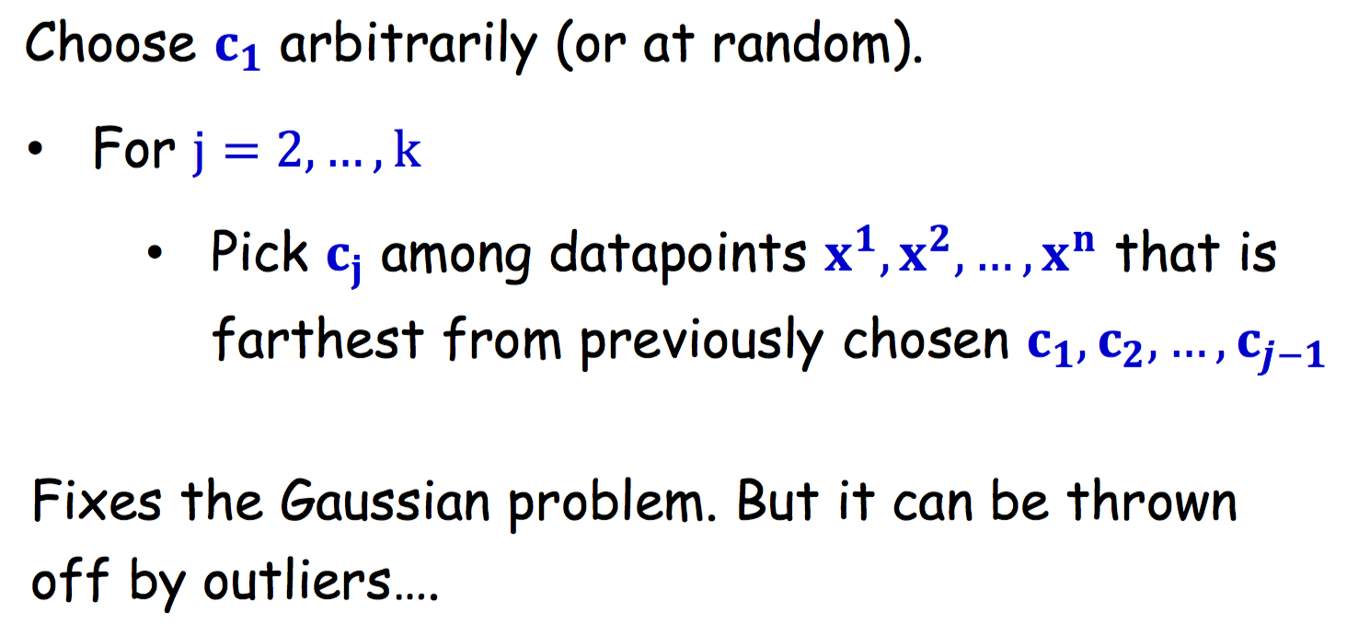
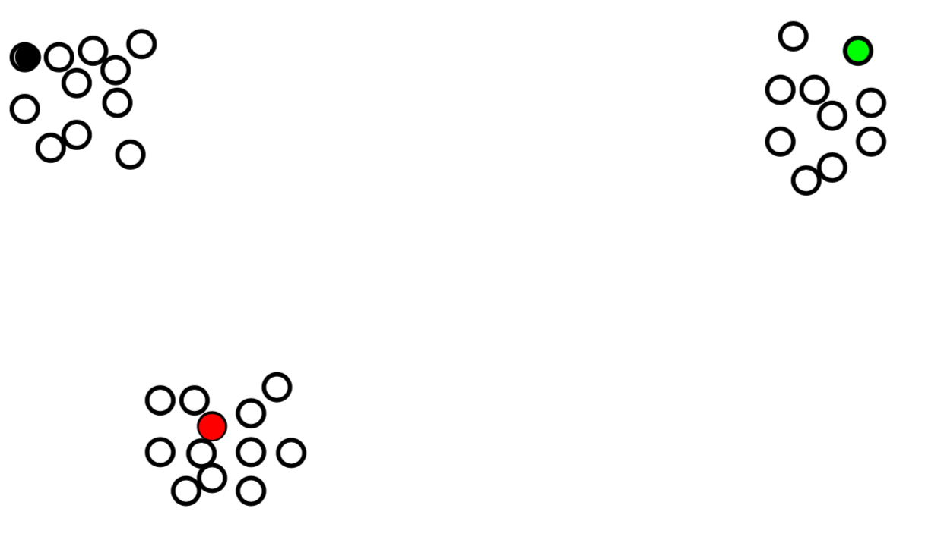
Ob
Furthest point heuristic does well on previous example

Slide 15
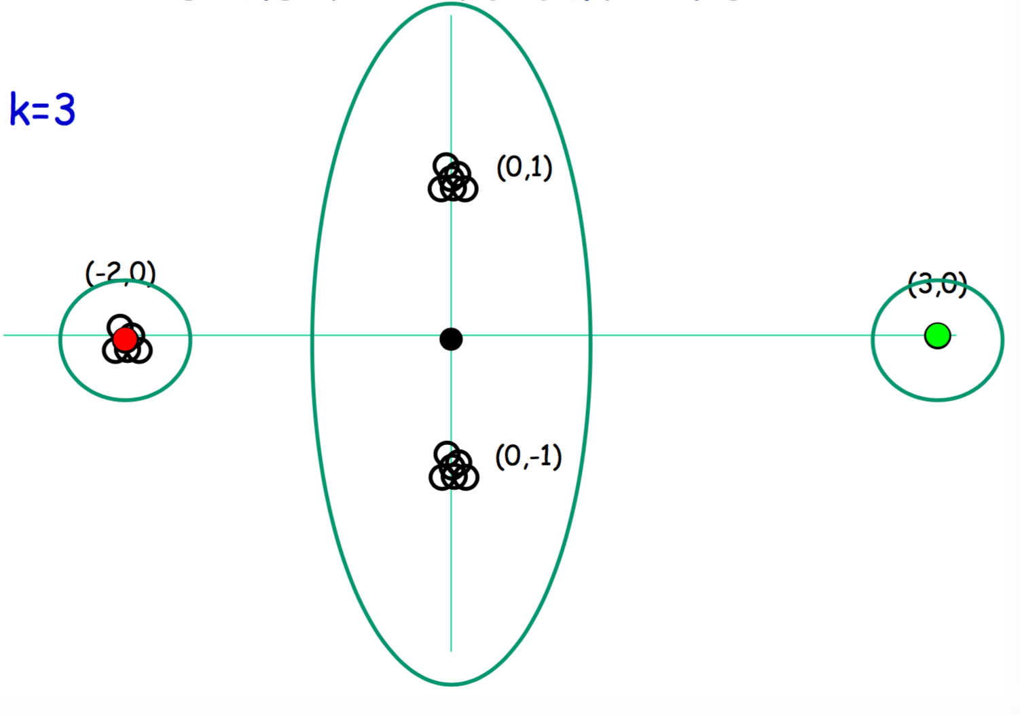
Ob
Furthest point initialization heuristic sensitive to outliers

Slide 16
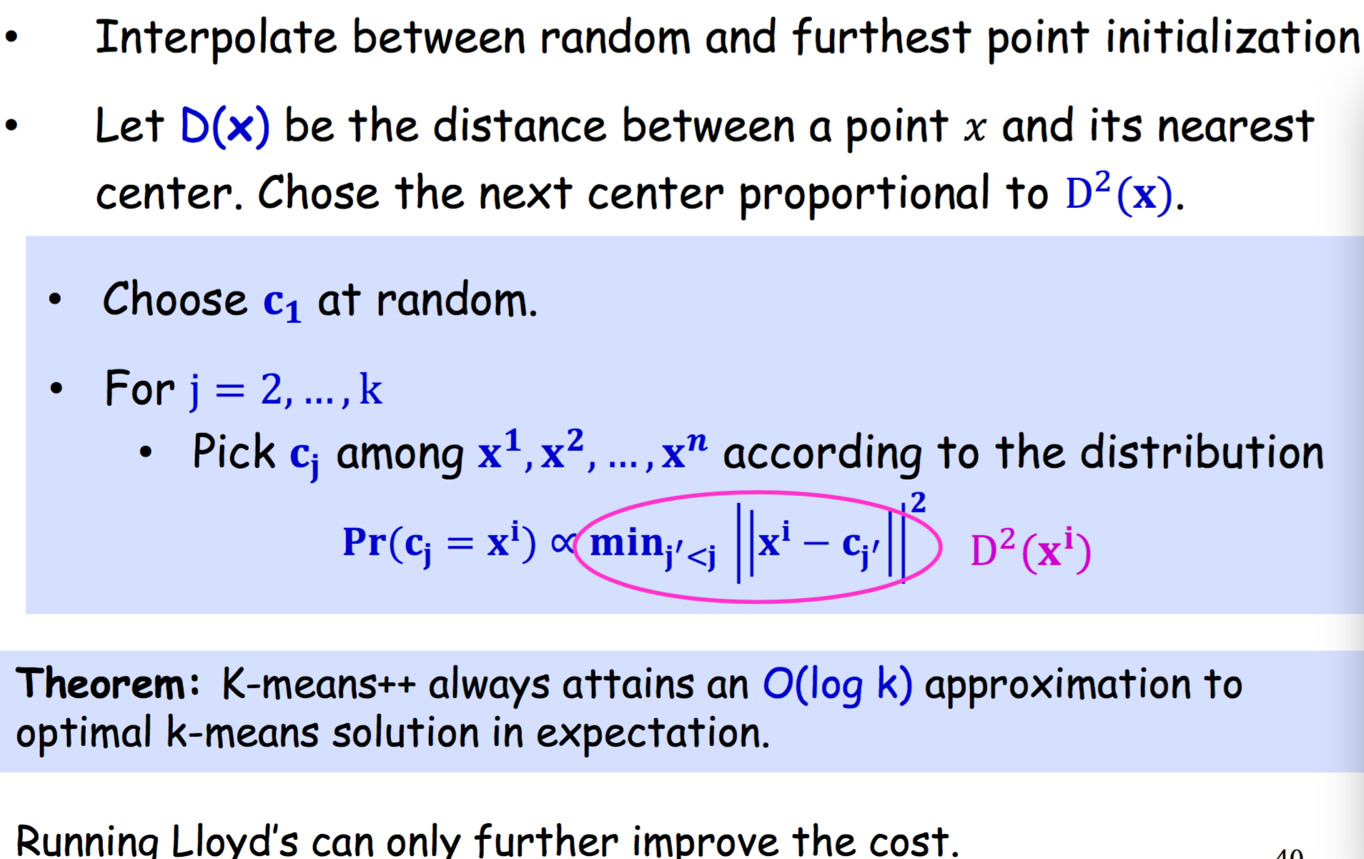
Ob
K-means++ Initialization: D2 sampling [AV07]

Slide 17
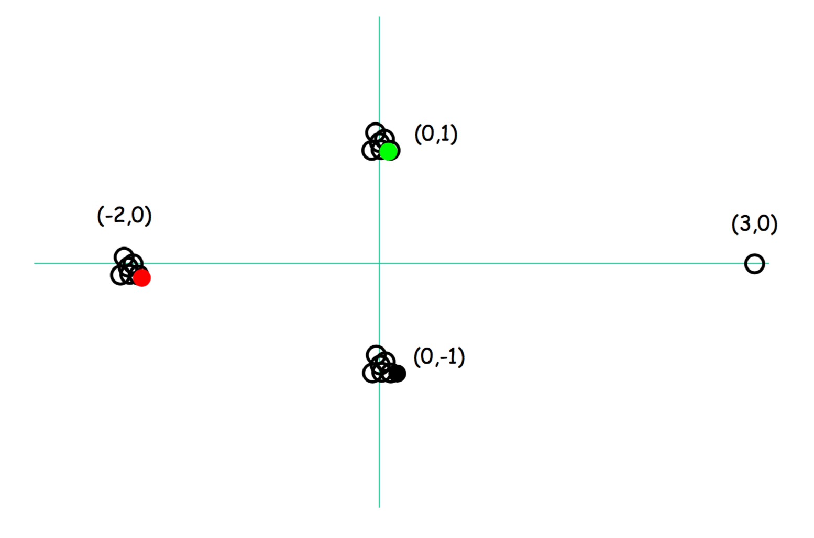
Ob
K-means ++ Fix

Slide 18
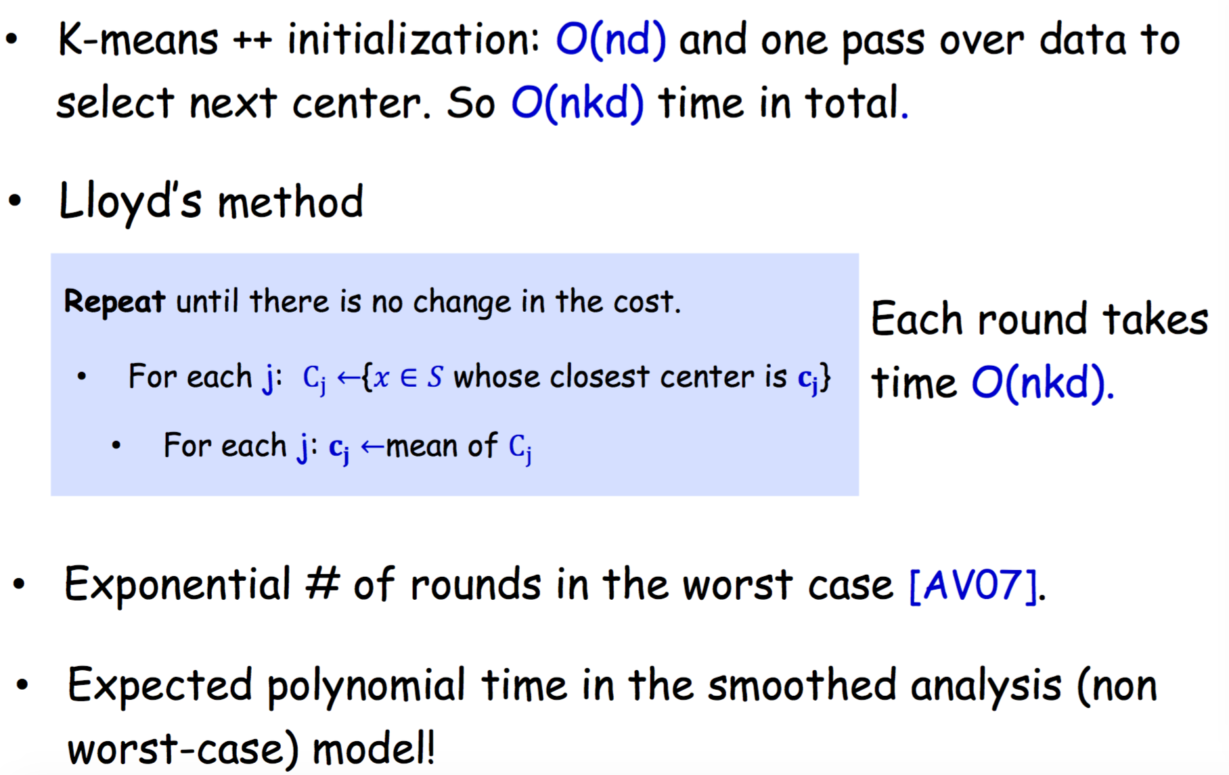
Ob
K-means++/ Lloyd’s Running Time

Slide 19
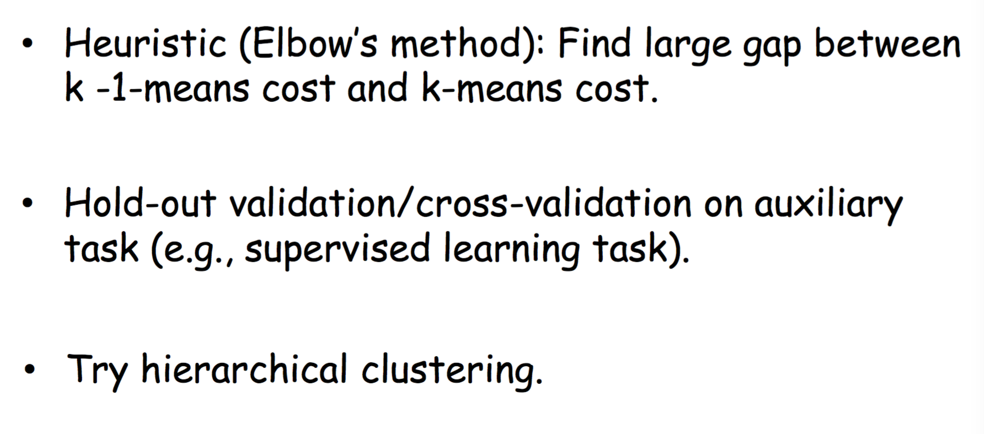
Ob
What value of k???

Slide 20
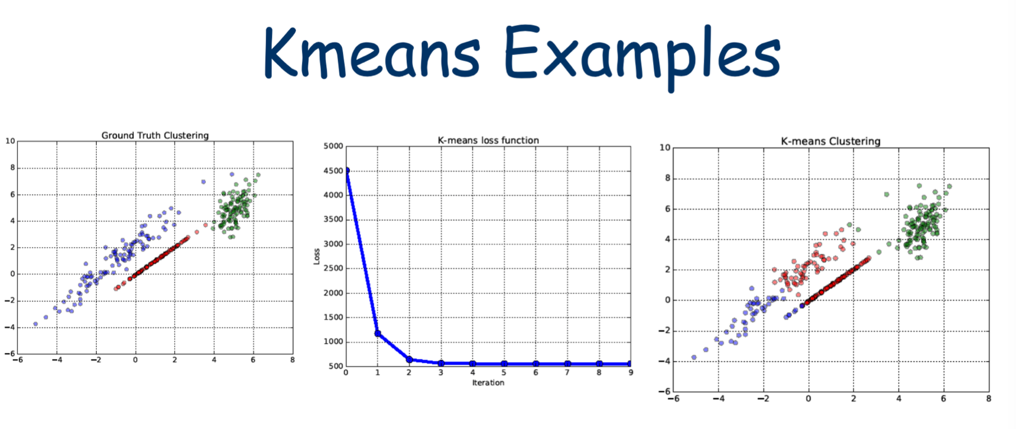

Slide 21
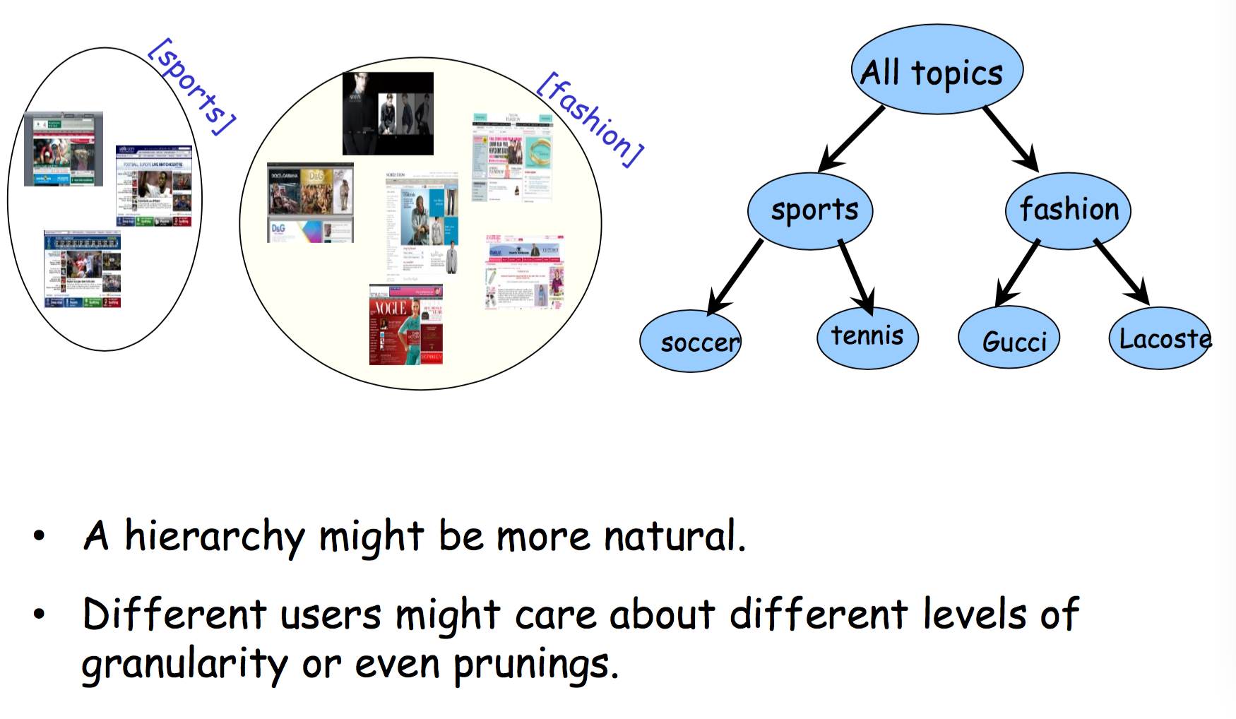
Ob
Hierarchical Clustering

Slide 22
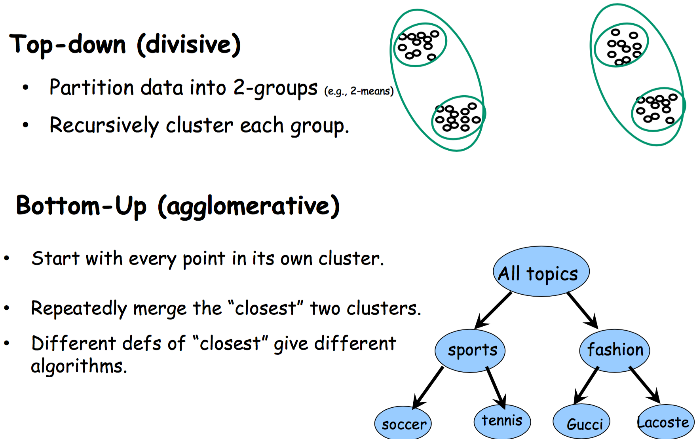
Ob
Hierarchical Clustering

Slide 23
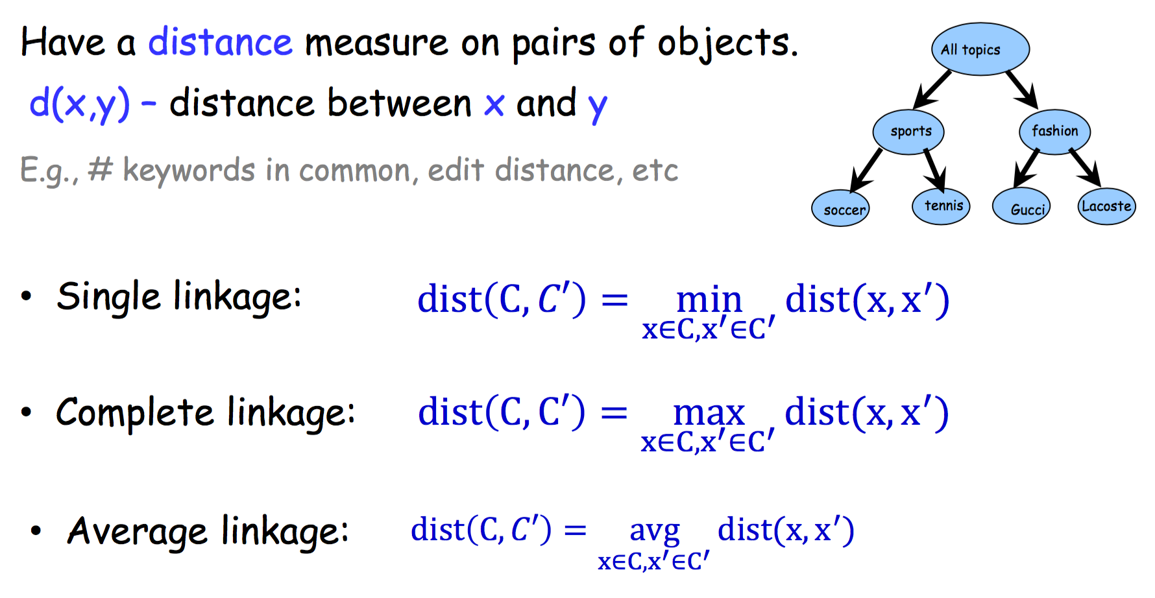
Ob
Bottom-Up (agglomerative)

Slide 24
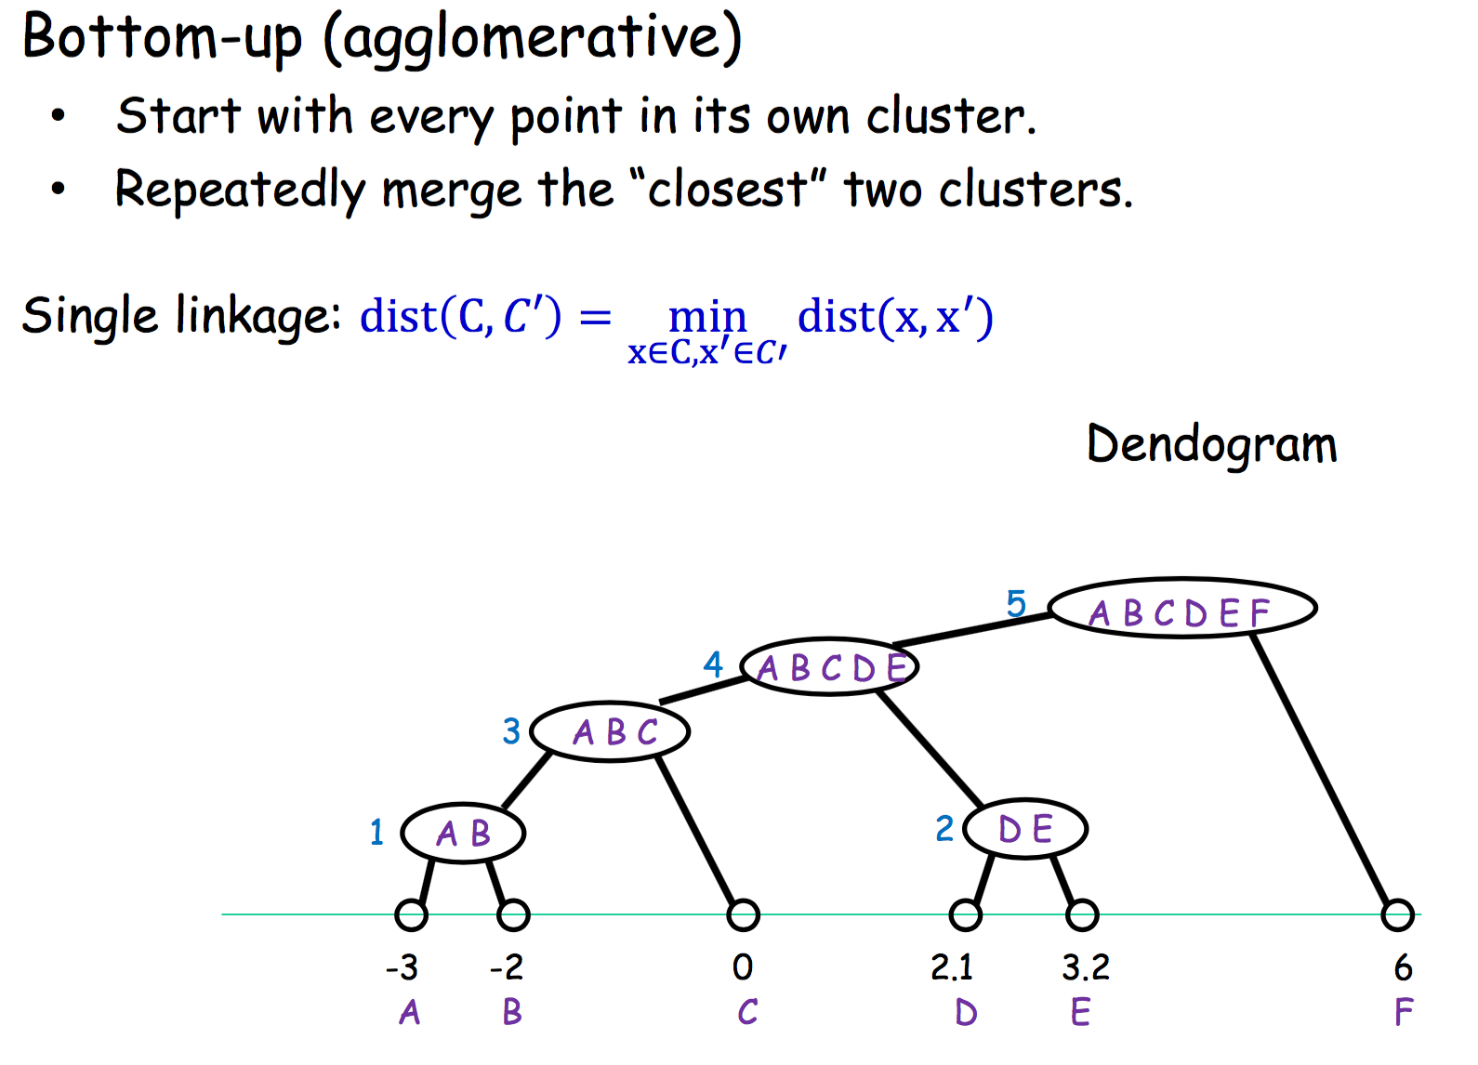
Ob
Single Linkage

Slide 25
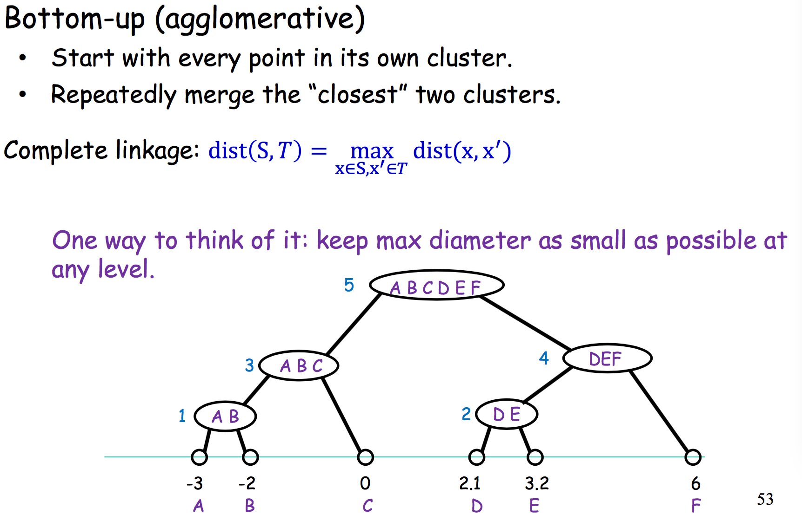
Ob
Complete Linkage

Slide 26
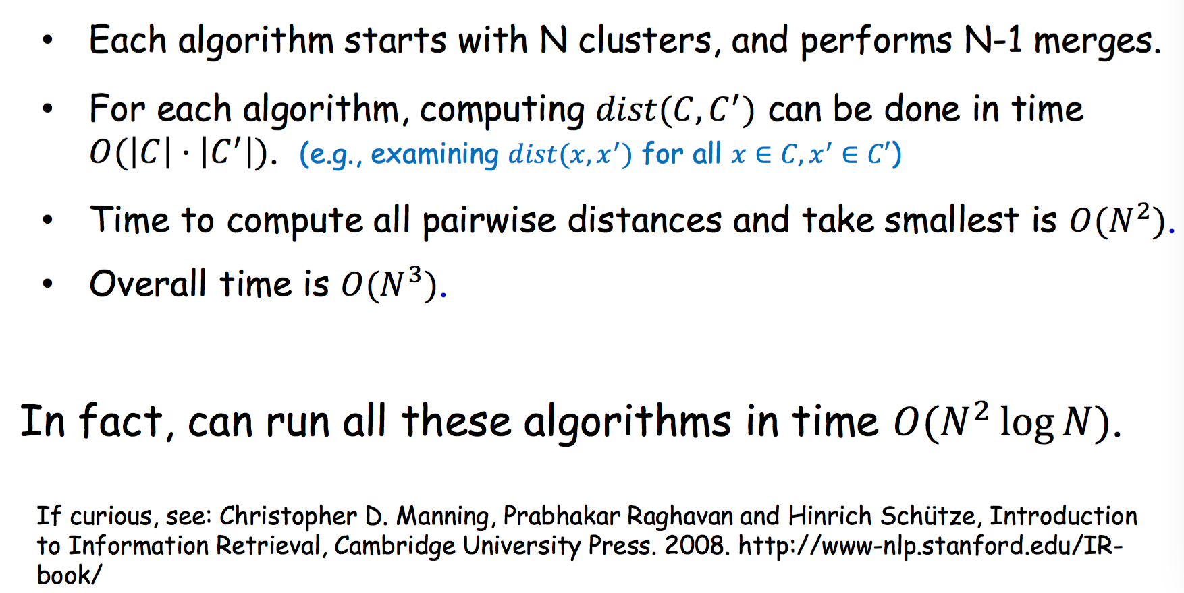
Ob
Running time for Single and Complete Linkage

Slide 27
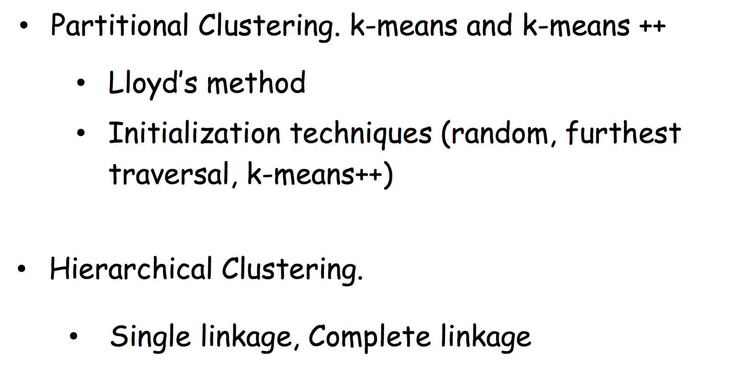
Ob
What You Should Know

